Slide 1


BA Project
1

Slide 2

Churn Analysis
Serginau LOUIS
Matteucci CYRIL
Moise MASSON
Date : 27-08-2021

Slide 3
Plan
Introduction - Team, Client, Problem
Systems Analysis of Problem - Review stakeholders, deﬁne measurements of performance
Relevant Analytics - Data sources, Analysis
Alternative Solutions - Explanation of solutions, comparison of outcomes
Recommendations - What should the client do next? What is the recommended next step?
Appendix - Additional Resources

Slide 4

Introduction
Presentation of the Team
The team is made up of three (3) members:
Serginau LOUIS: Data Analyst
Matteucci CYRIL: Data Analyst
Moise MASSON: Data Analyst
The client
Our client is Telecom Company, a company that provides various telecommunications services
Your problem
Your problem is that, in the face of the competition, you are losing customers, that is to say, a market share on which your profit depends.

Slide 5

Systems Analysis
Stakeholders
The company : the business has encountered a problem where it is unable to have customer growth because the competitors are creating a way to take customers.
Customer service team :The customer service team is responsible for reaching out to customers and convincing customers to stay.
Marketing team : The marketing team got to know the customers who were able to leave them and create content that they might be interested in.

Slide 6

Measurements of performance
Since your primary goal is to gain profits, Customer Churn is a problem you have to face and this is tantamount to capturing your customers in order to straighten your profits.

Slide 7
Relevant Analytics
Analysis
All the analysis is done in order to answer these questions:
How much is churn affecting the business? How big is churn compared to the existing customer base?
Explain churn by the below categories. Are there any factors that combine to be especially impactful

Slide 8
How much is churn affecting the business? How big is churn compared to the existing customer base?
The percentages indicated below for each service concern only the customers who have been subscribed to these services, they represent those who are still subscribed and those who moved out.

Slide 9
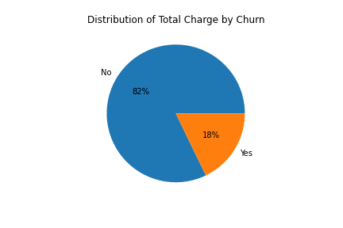
Here is the distribution of total customer charges, we can see that 82% of its charges come from customers who are still subscribed to the service of the company while 18% of were made by those who unsubscribed during this month.

Slide 10
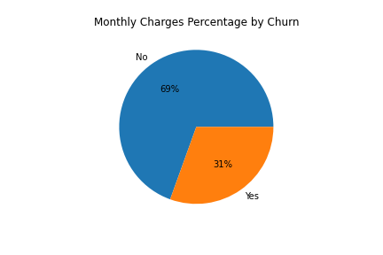
Here is the distribution of monthly customer charges, we can see that 69% of its charges come from customers who are still subscribed to the service of the company and while 31% of were made by those who unsubscribed during that month.

Slide 11
As we can see the services most affected by the churn are:
Streaming TV: 30%
Streaming Movies: 30%
Multiple line: 29%
The least affected services are:
Tech Support: 15%
Online Security: 15%

Slide 12
2- Explain churn by the below categories. Are there any factors that combine to be especially impactful
R:we can see that the majority of people who churn is who don't have dependents .

Slide 13
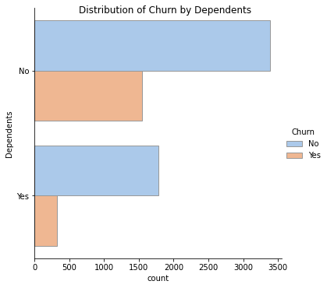

Slide 14
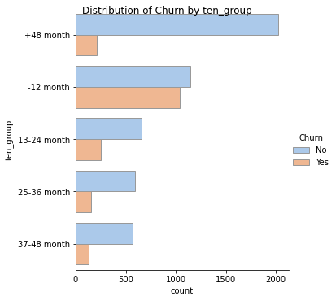

Slide 15
Potential Solutions
What is the current state?
What are the options the client can pursue?
Ideally try to put them on one slide for easier comparison, you can have separate slides to go into detail
Option 1:
- Profit Margin: 7%
Option 2:
- Profit Margin: 18%
Option 3:
- Profit Margin: 35%

Slide 16
Recommendations
What are you recommending and why?
What are the next steps with your recommendation? How can the client make an impact and change?
Performance Measurement: We need to create content that interests customers to stay and get other customers in the future, and from those customers the business will make a profit.
Solution 1: Give customers incentives so that they have a reason to stay.
Alternative Solution: improve internet service and telephone service.

Slide 17
Thank you!

Slide 18

Appendix
What resources can the audience use to further understand the message and story being presented?
https://github.com/engy06/Churn1.git

